Slide 1
Software Design and Architecture
Pattern Focus Design

Slide 2
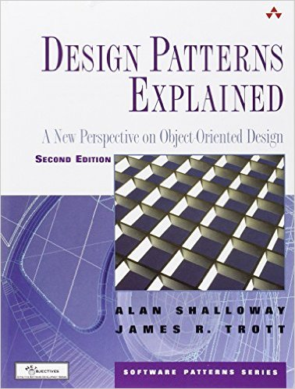

Slide 3
Intuitive Notion of Design
Design is to build by fitting things together: “build from pieces”
Indeed, this is the whole point of functional decomposition
decompose the problem into small pieces and then build up from there
And OO follows this with classes and objects
But Christopher Alexander indicates that this is NOT a good way to design

Slide 4
Alexander Approach
Design is often thought of as a process of synthesis, a process of putting together things, a process of combination. According to this view, a whole is created by putting together parts.
The parts come first: and the form of the whole comes second.

Slide 5
Design for Everyone
The interesting thing is that design is something that can be learned by anyone
A design that follows well-established patterns will produce good, solid results; it should not be surprising that quality solutions for similar problems appear very much alike
For instance, following Model-View-Controller brings benefits to even the most novice of designers…

Slide 6
The Steps
Within the context of a design
Identify patterns that can add information to the design
ones that define useful relationships between entities of the design (or suggest entities and relationships not currently present that would benefit the design)
Add them to the design, thus updating the context
Repeat, until no more entities and relationships are needed to solve the problem

Slide 7
Example
Design a system that aids a geologist in assigning ages to rock samples collected from the field
Context Pattern: Desktop Application
Leads to: Model-View-Controller
Model Leads to: Database of Rock Samples
View Leads to: Collection Browser and Operations
Controller: Set of “glue” objects that invoke operations on selected samples, updates database, displays results

Slide 8
Review of CAD/CAM Problem
Design software that translates CAD designs that use the parts above into instructions for a machine that punches the actual part out of sheet metal

Slide 9
System Overview

Slide 10
Example of encapsulation via software architecture…

Slide 11
The First Solution
For each Feature class, the version 1
variation will have attributes that link to
the version 1 model id and the feature id; it will then call the V1 library routines
directly
The version 2 variation will simply wrap
the Feature class that comes from the
CAD system
The arrow with dashed line means “uses”

Slide 12
The First Solution

Slide 13
Pattern Focus
To develop a better solution to this problem, let’s think in terms of patterns
What are the essential concepts of the problem domain and what relationships exist between them?
This can help us identify patterns that can be applied
This doesn’t always work (design is hard) but patterns can often get you moving in a particular direction

Slide 14
Thinking in Patterns (big picture view)
Step 1: Identify the Patterns
Step 2: Analyze and apply the patterns
2a. Order the patterns by context creation
2b. Select pattern and expand design
2c. Identify additional patterns, add them to the set
2d. Repeat
Step 3: Add detail

Slide 15
Step 1: Identify the Patterns
For the CAD/CAM Domain, the possible patterns are
Abstract Factory: Create parts for a particular CAD system
Adapter: Adapt new CAD systems to the target interface
Bridge: Implement the abstractions of the domain by “bridging” to a particular CAD system
Facade: keep the complexities of the CAD system hidden from the expert system

Slide 16
Step 2a: Which pattern provides context for the others?
Look through all possible parings of the identified patterns
Does x provide context for y?
Does abstract factory provide a context for bridge?
Look back at our Pizza shop example for inspiration
To help with these decisions look at the patterns conceptually…

Slide 17
Step 2a: Which pattern provides context for the others?
Abstract factory creates sets of related objects
Adapter adapts existing class A to the interface needed by a client class B
Bridge allows for different implementations to be used by a set of related client objects
Facade simplifies an existing system A for a client class B

Slide 18
Step 2a: Which pattern provides context for the others?
Abstract factory’s context is the structure of the objects its creating
Pizza is made of dough, sauce, toppings, etc.
It does not provide context for other patterns
This is true of most “creational patterns”
So, scratch it off the list
This leaves
Adapter <=> Bridge; Bridge <=> Facade; Facade <=> Adapter

Slide 19
Step 2a: Which pattern provides context for the others?
Bridge <=> Adapter
Adapter will allow the expert system to access the OO interface of the new CAD system by making it conform to Feature and its subclasses
Bridge will ensure that Feature and its subclasses can access version 1 and 2 of the CAD system
Bridge provides context for Adapter

Slide 20
Step 2a: Which pattern provides context for the others?
Bridge <=> Facade
Facade will simplify the complex interface of the first CAD system
Bridge will ensure that Feature and its subclasses can access version 1 and 2 of the CAD system
which means making use of the Facade
Bridge provides context for Facade (in this system)
Since Bridge “wins” twice, its the outermost pattern

Slide 21
Step 2b: Select Pattern and Expand Design
How does Bridge fit into the conceptual whole of the design?
What, exactly, provides a context for the Bridge pattern?
The elements of the problem domain!
Expert System uses Model
Model aggregates Features (abstractions)
Different CAD systems provide different types of features (implementations)
The Bridge pattern!!

Slide 22
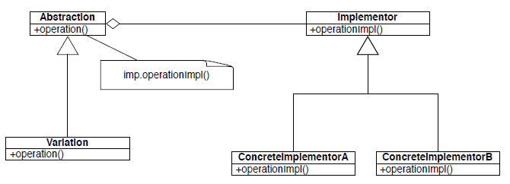
Bridge Structure Diagram

Slide 23
Bridge in Context
Assumes that Feature has a public interface that provides all of the information needed by the expert system

Slide 24
2c: Identify additional patterns
All that is left in this particular system is to attach the V1 and V2 systems to the design
Adapter and Facade will do that for us, so no additional patterns are needed
Looping back, we know that Adapter and Facade are independent of each other in this design
They can be applied in any order

Slide 25
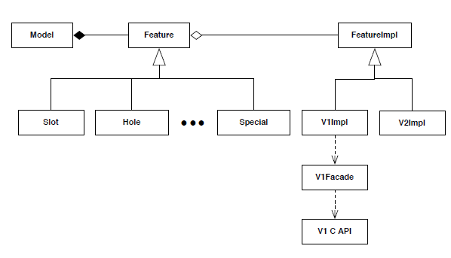
Context for Facade

Slide 26
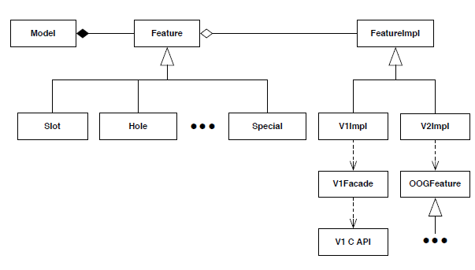
Context for Adapter (& Final Design)

Slide 27
Step 3: Add Detail
At this point, we would start to add detail
What exactly is the public interface of Feature and FeatureImpl
How will each subclass of Feature implement that public interface by calling operations on FeatureImpl?

Slide 28
Is it better?
Is the new design better?
The new design sounds simpler (especially because it can be explained using design patterns)
Now consider, what happens when V3 of the CAD system comes along…
6 new subclasses in 1st design; 2 new classes in the 2nd

Slide 29
Class Focus vs. Pattern Focus
In the first design, we got to a state that works but it wasn’t that maintainable
it had a class-based focus that stuck parts together from the bottom up, creating a whole
In the second design, we started with the big picture, found the most suitable pattern and worked down, adding patterns that worked with the first one
the patterns then deliver on good software qualities because that’s what they are all about!

